Slide 1
Create VMSS
MANOJ

Slide 2
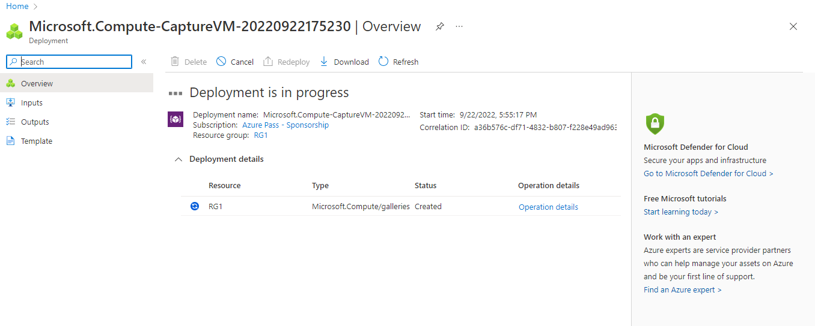
Backup of Instance (creating the Capture image using existing VM)

Slide 3
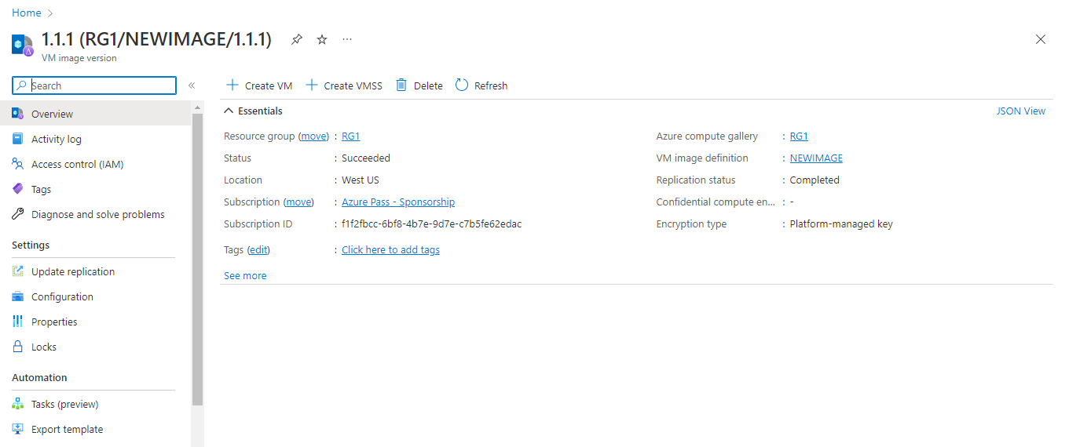
Created Capture Image using VM

Slide 4
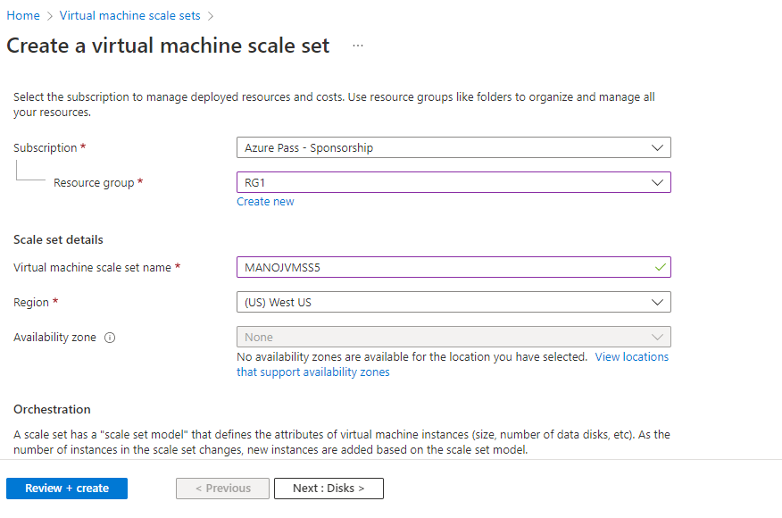
VMSS Creating Using Captured Image

Slide 5
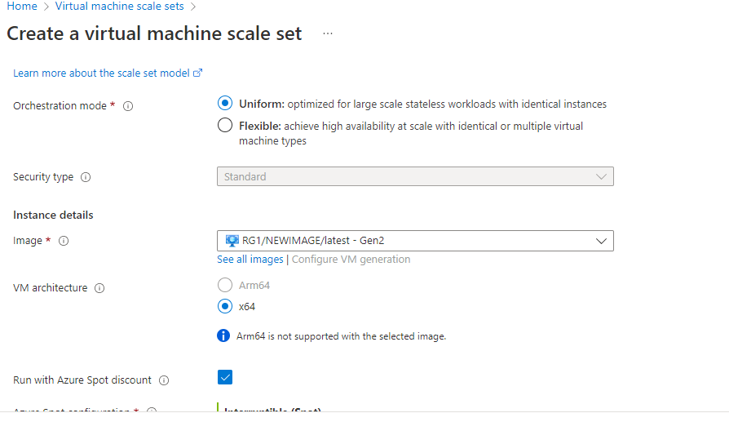

Slide 6
